Slide 1
Software Tech 1-Capstone Project
U3253277, Shiva Banda
Thursday 5:30 pm

Slide 2
Table Of Contents:
Problem Statement
Data Introduction
5-9: EDA Tests
Data Modelling
Deployment (GUI)

Slide 3

Problem statement:
Exploring a provided dataset using a range of Python libraries for the purpose of conducting exploratory data analysis is the focus here. This academic exercise will outline a systematic process, leveraging well-established Python libraries such as Pandas, Matplotlib, Seaborn, and Plotly.

Slide 4
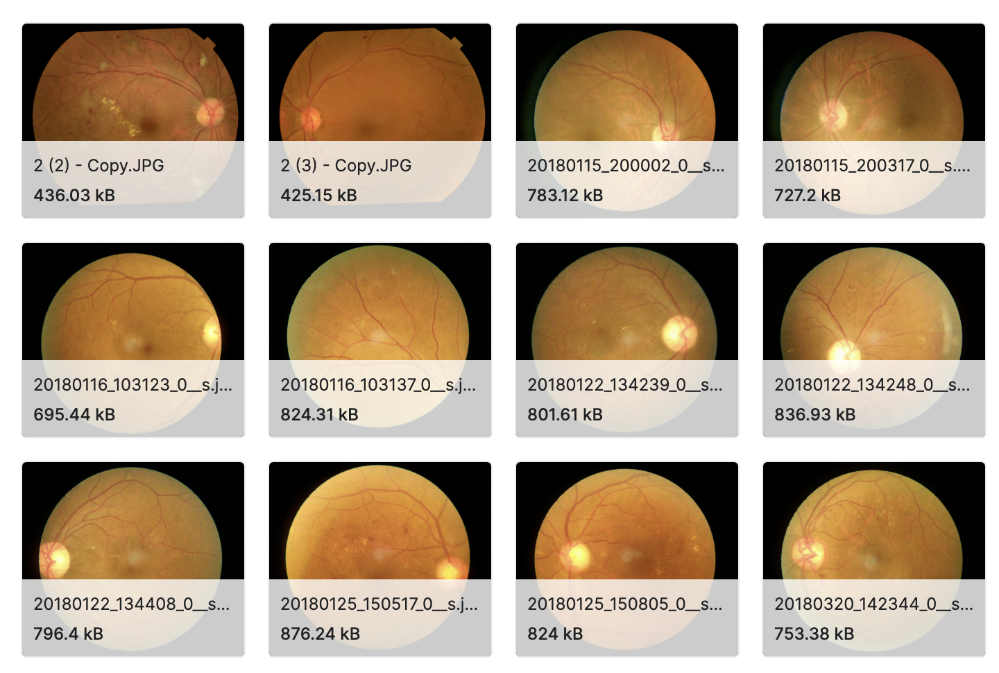
Diabetic Retinopathy
DataSet Description:
The AGAR300 dataset enables benchmarking of computer-aided algorithms for early Diabetic Retinopathy detection through Microaneurysm identification in 28 color fundus images. Published in Biomedical Signal Processing and Control, Elsevier.

Slide 5
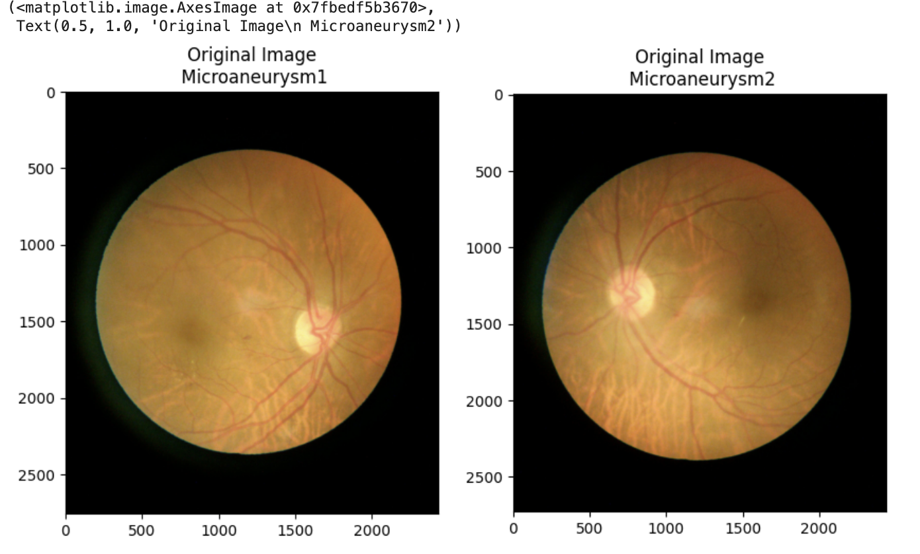
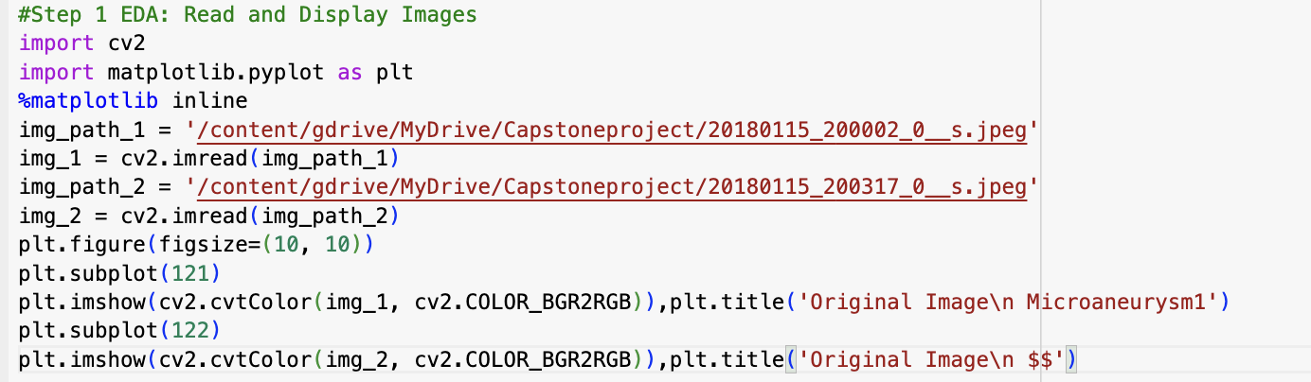
First Test:
Reading The right file Paths and Displaying images.
FIle Path for this test from google drive.
The two images used for this test was Microaneurysm2, microaneurysm1.

Slide 6
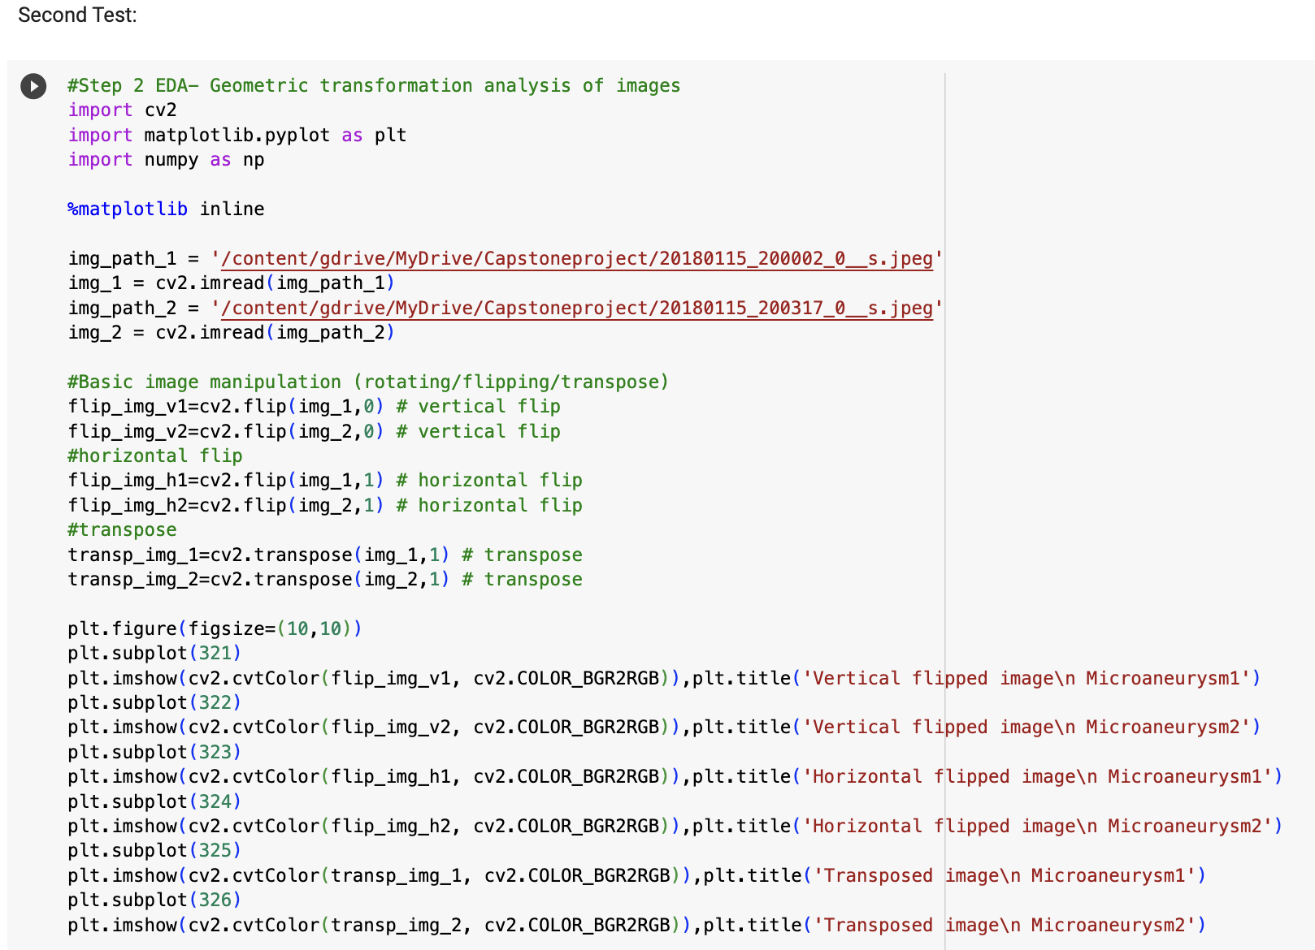
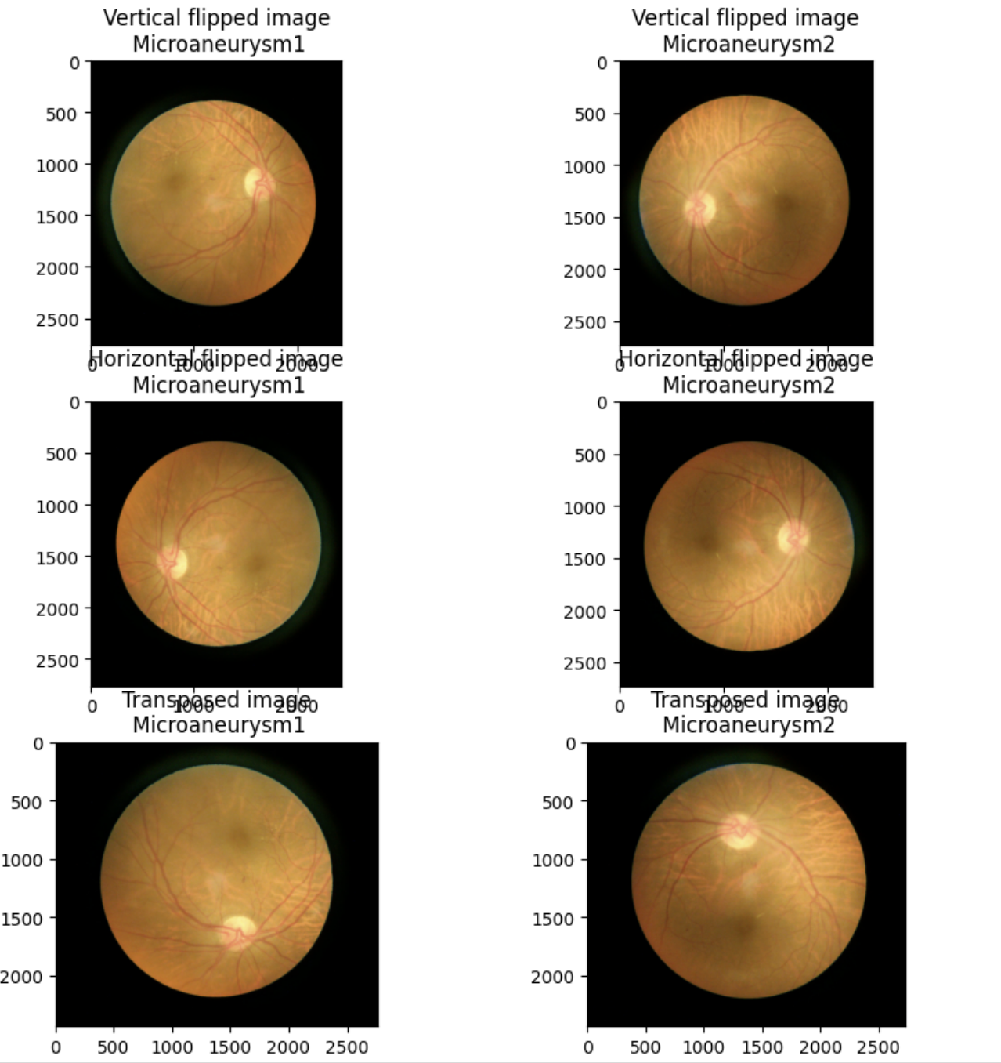
Second Test:
The second test does the first test and more, it reads the file paths, displays images, and then geometrically manipulates the images using the code below.

Slide 7
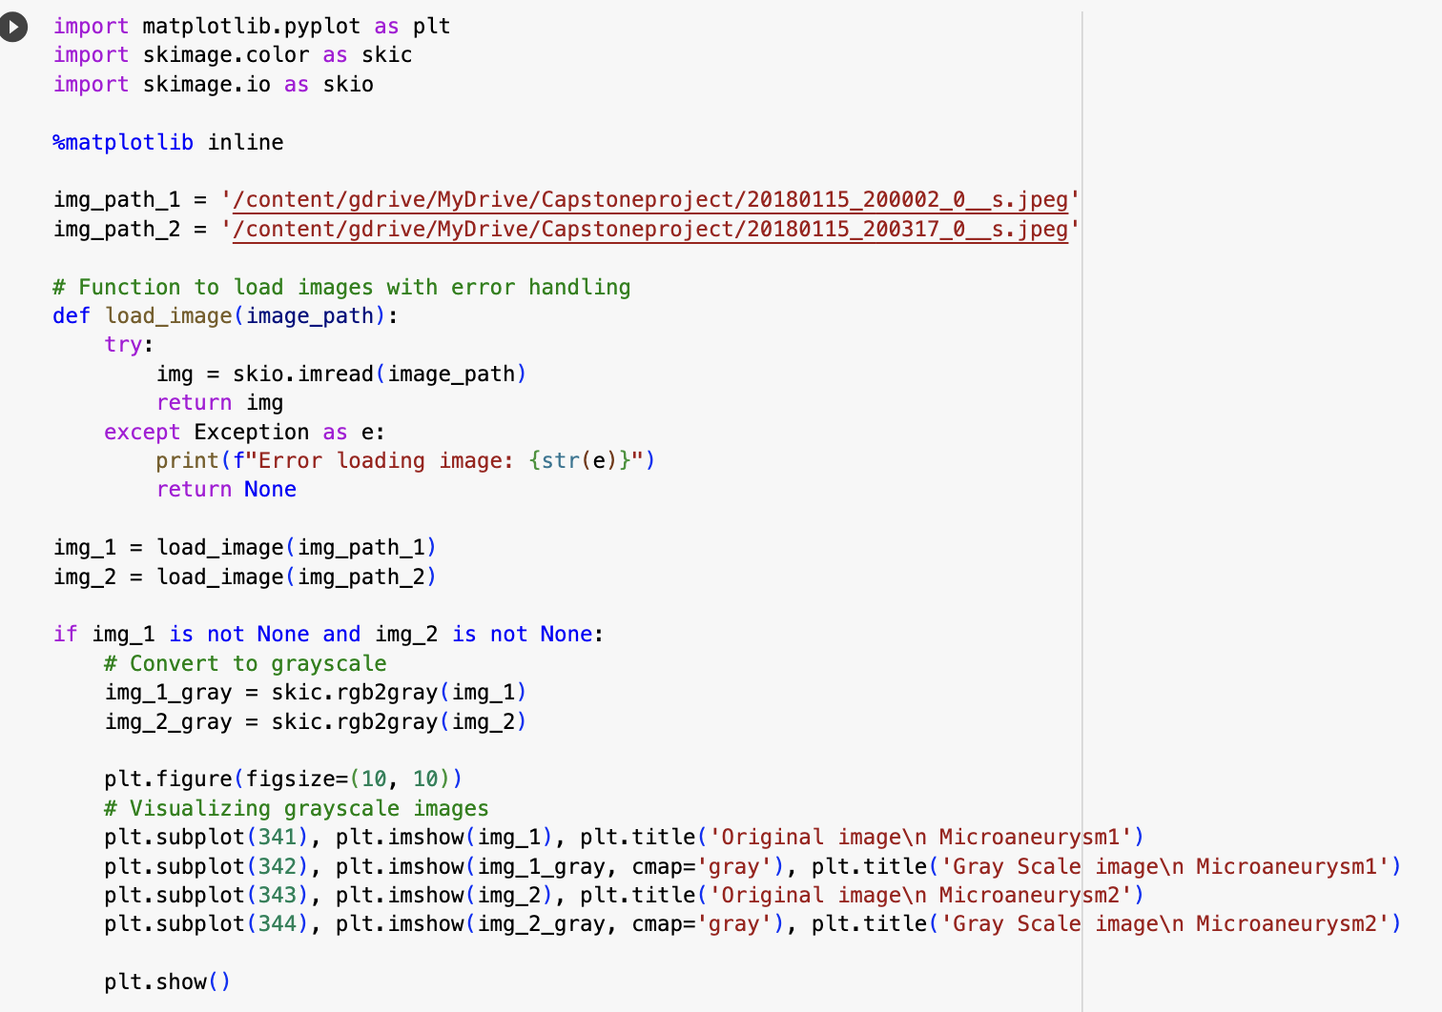
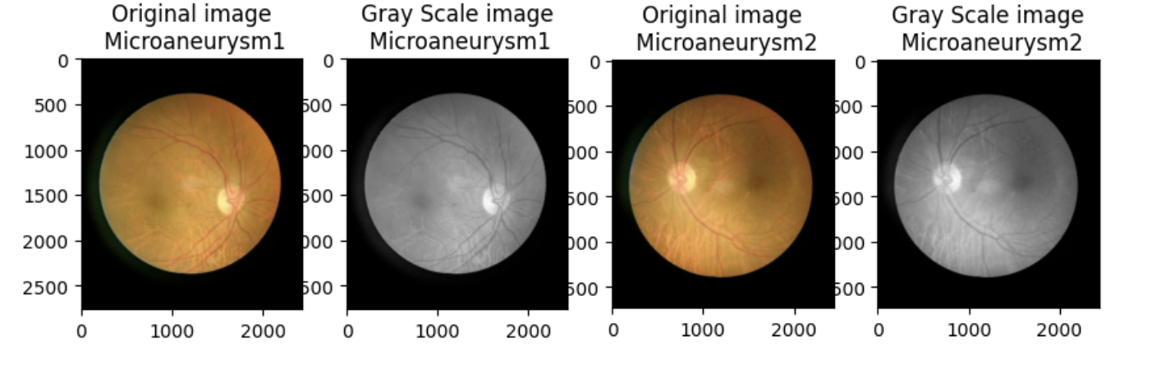
Third test:
This test follows the first test’s format and proceeds to manipulate the colour of the images changing it to grey.

Slide 8
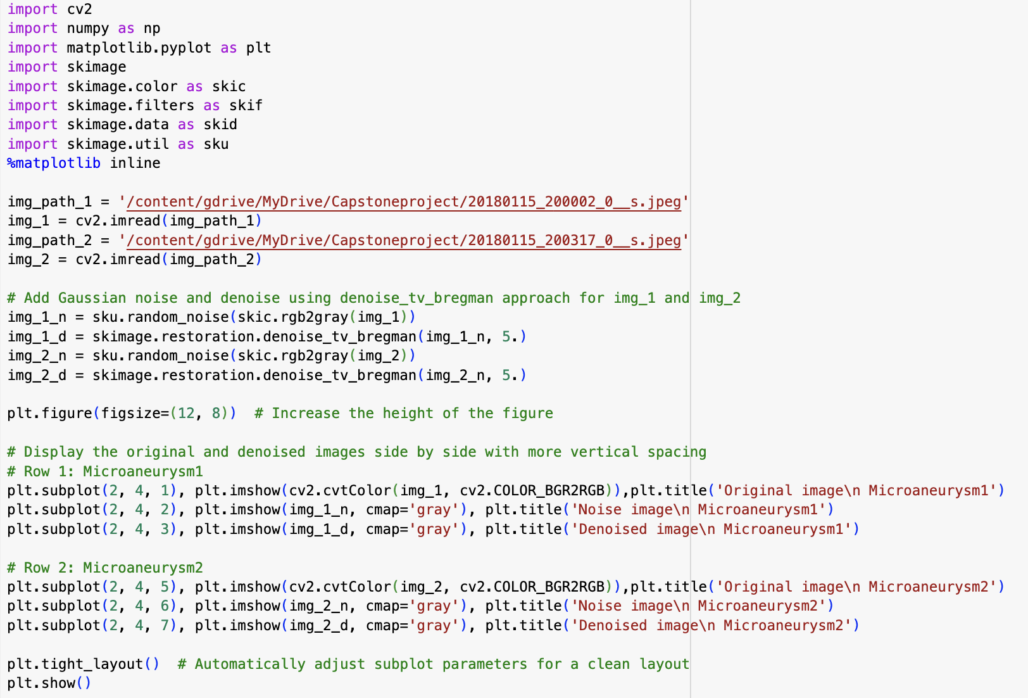
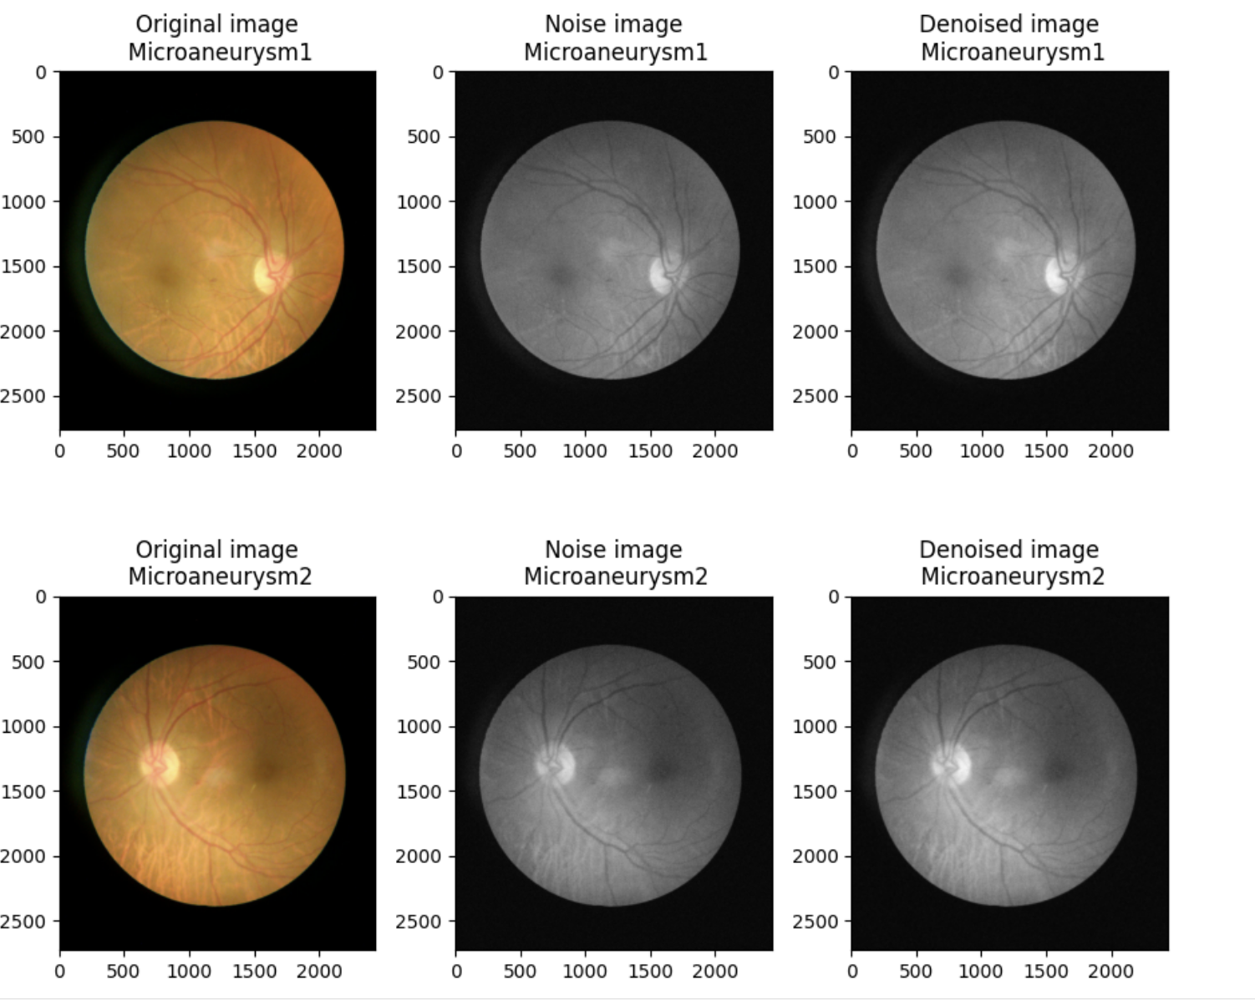
Fourth Test:
The fourth test was designed to reduce the quality of the images to see how the program interprets the image.

Slide 9
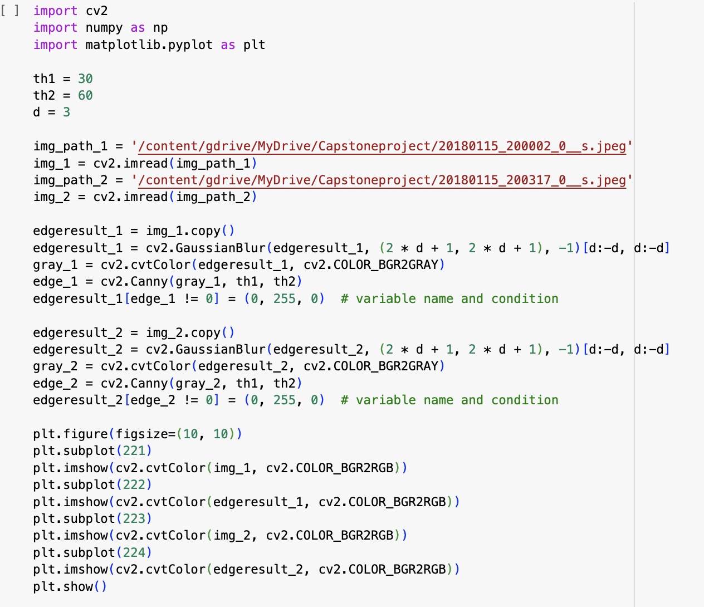
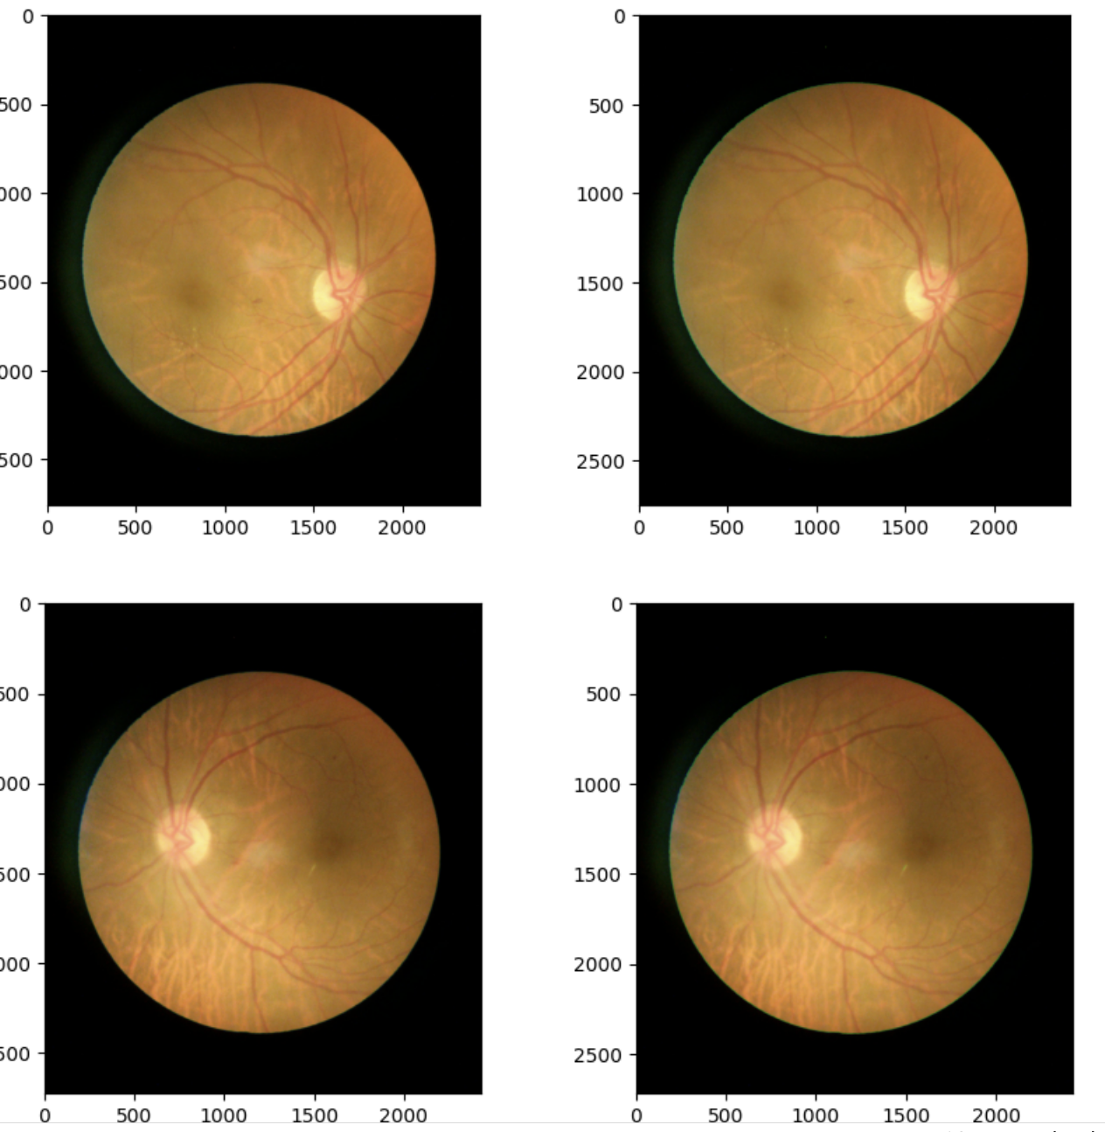
Fifth test:
The final stage is using canny edge detection to draw on the edges visible to the program. This can be used to determine edge patterns within an image and make it easier to tell the classes apart. Can also be applied to manipulated images to see if the edges match to be able to determine image class.

Slide 10
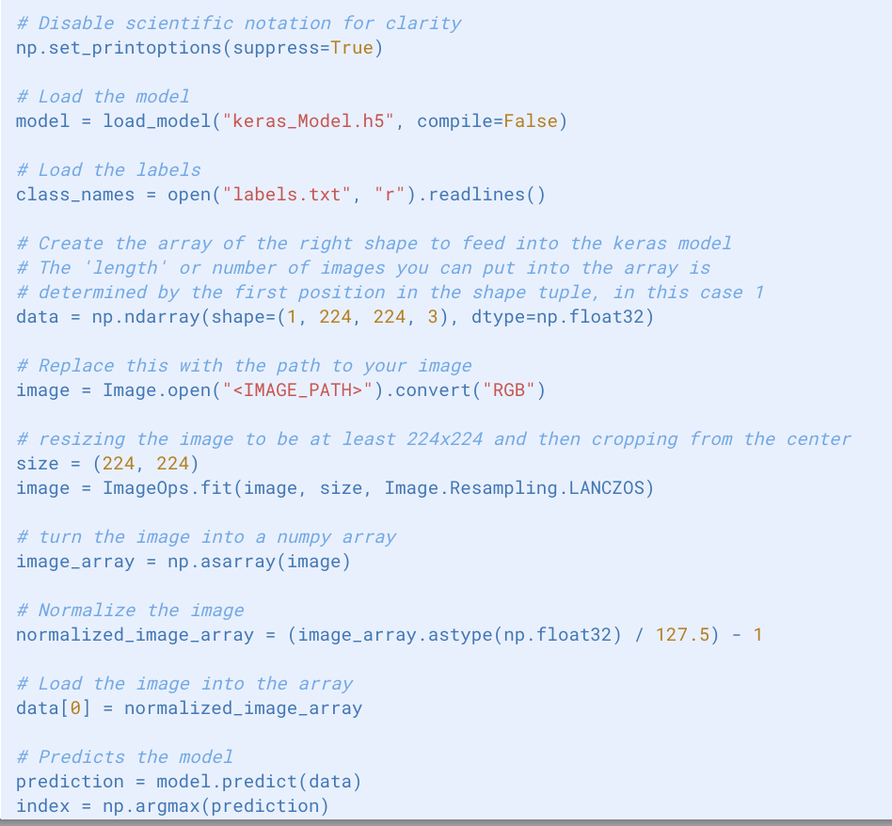
Data Model (PDA)
Using teachable machine, a data model was created that is able to take an input image and then display what class it believes it to be a part of as well as displaying a confidence score.

Slide 11
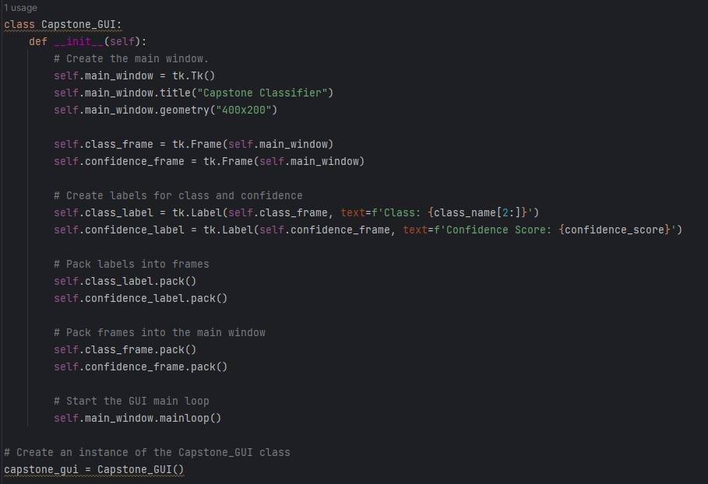
GUI:
Besides the code for the data model, a basic graphical user interface (GUI) has been developed to exhibit the class_name and confidence_score variables. While the GUI is a work in progress, it presently functions and shows the relevant information it lacks depth and can be significantly improved before the final deadline. Further enhancements are planned for the GUI.

Slide 12
THANK YOU:)

